Slide 1
BASA Internal Competition
Apple App Store Classification
Group 2
Lan Ken Nhan Po-Nien Chiang
Xiaoxuan Iris Feng Yufei Lisa Wang

Slide 2
1
Executive Summary
CONTENTS
2
Data Description & Manipulation
3
Feature Engineering
4
Classification Model

Slide 3
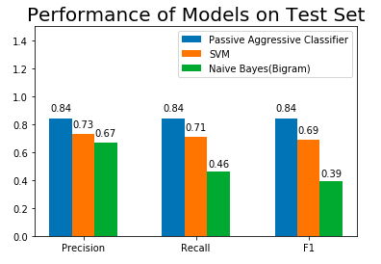
Executive Summary

Slide 4



Executive Summary
Raw Data
Building Model
Data Cleaning
Insights

Slide 5
2
Data Description & Manipulation

Slide 6
Data Description & Manipulation
Variables | Type | Number of Unique Values | Function
Description | text(unique) | 459,090 | predictor
Category | text | 43 | predictor
Sub category | text | 503 | target
Data Summary
Training: 459,090 (80%)
Testing: 114,773 (20%)
Data cleaning
Remove stop words, punctuations and special characters (e.g. *)
Stemming

Slide 7
3
Feature Engineering

Slide 8

Bag of Words
“I like Business Analytics”
I
“I like Business Analytics. Business Analytics I like. Business Analytics. Business Analytics. I like.”
Business
like
Analytics

Slide 9
Term Frequency
Sentence 1: "I like Business Analytics”
Sentence 2: "Business Analytics is a good major"
 | I | like | Business | Analytics | is | a | good | major
Sentence 1 | 1 | 1 | 1 | 1 | 0 | 0 | 0 | 0
Sentence 2 | 0 | 0 | 1 | 1 | 1 | 1 | 1 | 1

Slide 10
Term Frequency
Unigram { I, like, Business, Analytics }
Bigram { I like, like Business, Business Analytics }
n-gram is a sequence of n items from a given sample of text

Slide 11
Term Frequency
“… mobile banking …”
“… mobile banking …”
mobile banking
“… mobile banking …”
“… mobile banking …”
“… mobile banking …”

Slide 12
Term Frequency
“… payment …”
“… payment …”
mobile banking
“… payment …”
“… payment …”
??
“… payment…”
“… payment …”
“… payment …”
payment processing
“… payment …”
“… payment …”

Slide 13
Term Frequency - Inverse Document Frequency
Stop words
Inverse Document Frequency
penalty for words with high frequency in all documents
Common words
Frequency
Rare words
TF-IDF

Slide 14
4
Classification Model

Slide 15
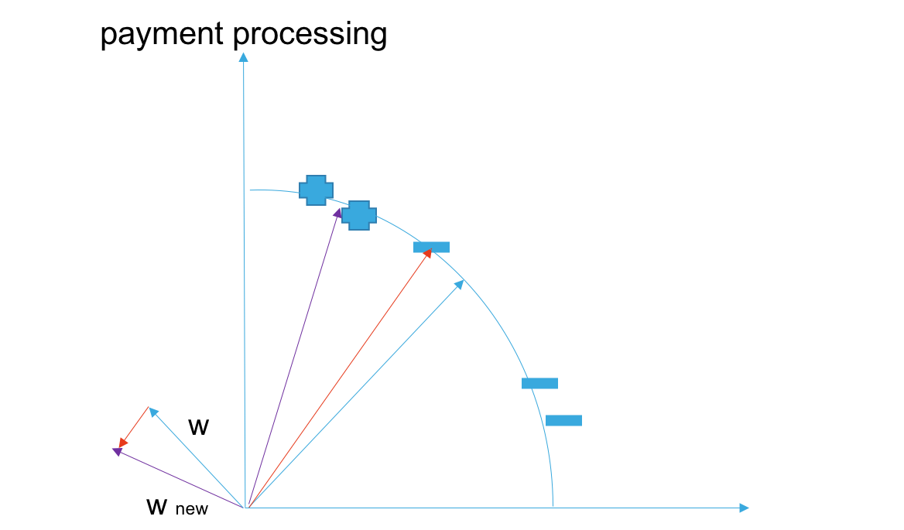
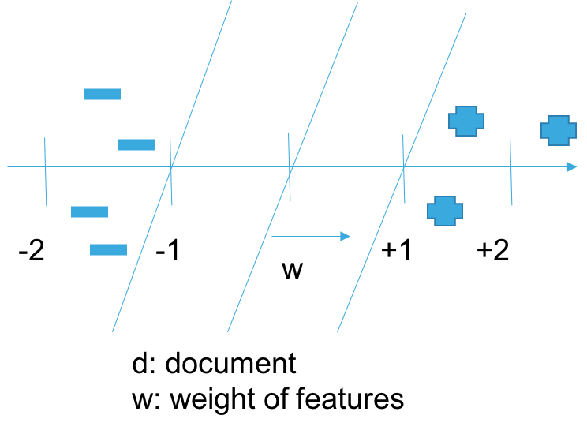
Passive Aggressive Classifier
Online Algorithm: Learning from streams of data.
Aggressive
Passive
dw
mobile banking

Slide 16
Cross Validation Results (F1 score)
 | Passive Aggressive Classifier | SVM | Naïve Bayes
1 | 0.78 | 0.64 | 0.39
2 | 0.78 | 0.64 | 0.39
3 | 0.78 | 0.64 | 0.39
4 | 0.78 | 0.64 | 0.39
5 | 0.78 | 0.63 | 0.39

Slide 17
Trade-off Analysis
Model | Precision | Recall | F1 | Model Fit
Passive Aggressive Classifier | 0.83 | 0.78 | 0.79 | Partial
Passive Aggressive Classifier | 0.84 | 0.84 | 0.84 | Global

Slide 18

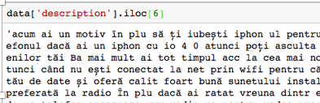
Future Improvements
Dimension Reduction
Language Translation

Slide 19
THANK YOU!

Slide 20
Backup Slides

Slide 21
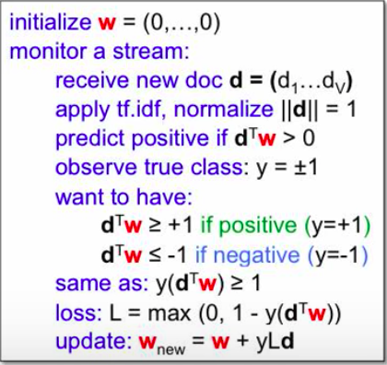
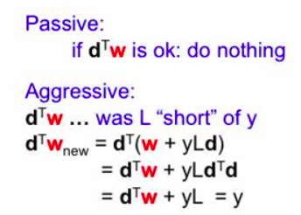
Model - Pseudo Code and Logic

Slide 22
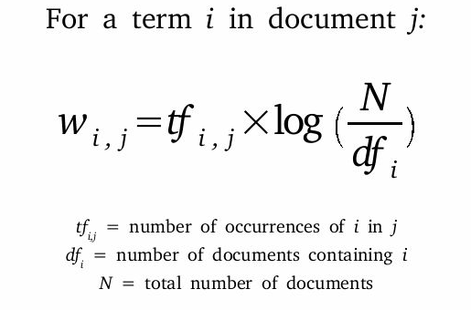
Feature Engineering – TF-IDF
Term Frequency - Inverse Document Frequency
df (high)
Stop words
Frequent words
Rare words
df (low)
W (low)
W (high)

Slide 23
Hashing Vectorizer
Hash Function
text1: [1,1,1,1,0,0,0,0]
text2: [0,0,1,1,1,0,1,1]
text3: [1,1,1,1,0,1,0,0]
text4: [0,0,1,1,1,0,1,1]
1
2
3
Hashing Trick
It is a space-efficient way of vectorizing features.
It works by applying a hash function to the features and using their hash values as indices directly, rather than looking the indices up in an associative array.
Avoid Collision
ξ(feature)=±1

